Slide 1

Business Central 2022 wave 2
And some other improvements

Slide 2

Connect to Azure functions
Business central 2022 wave 2
https://github.com/microsoft/ALAppExtensions/tree/main/Modules/System/Azure%20Function

Slide 3
Integrate Business Central with SharePoint
Business central 2022 wave 2
https://github.com/microsoft/ALAppExtensions/tree/main/Modules/System/SharePoint

Slide 4
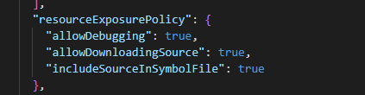
Apply resource exposure policy to DEV extensions
Business central 2022 wave 2

Slide 5

Modern bar
Business central 2022 wave 2
Combine multiple UI actions with a split button
Promoted action groups and action references

Slide 6
Define custom actions in AL code
Business central 2022 wave 2
For pages
customaction(MyFlowAction)
{
CustomActionType = Flow;
FlowId = '<the-GUID-identifying-the-Power-Automate-Flow>';
FlowEnvironmentId = '<the-GUID-identifying-the-Power-Automate-environment>’;
}
https://make.powerautomate.com/environments/<environment ID>/flows/<flow ID>

Slide 7
Debug options
Business central 2022 wave 2
Exclude temporary records when debugging record writes
Exclude Try functions when debugging errors
Launch in a specific company from Visual Studio Code

Slide 8
View SQL locks during AL debugging
Business central 2022 wave 2
VS Code

Slide 9
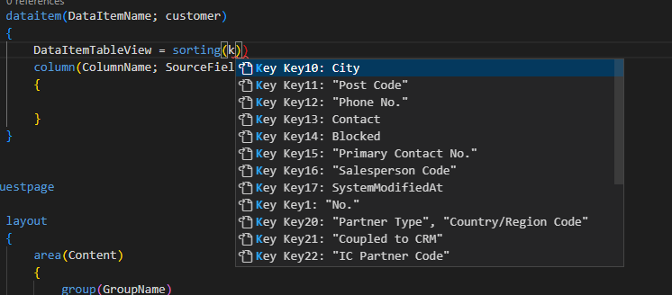
IntelliSense for defining sorting on data view properties now includes table keys
Business central 2022 wave 2
DataItemTableView property on reports
SourceTableView property on pages and XMLPorts

Slide 10
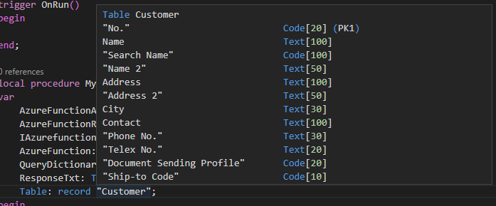
See the primary key for table fields in IntelliSense
Business central 2022 wave 2

Slide 11
Use option access syntax in formulas
Business central 2022 wave 2
Old: SourceTableView = where("Source Type" = const(18));
New: SourceTableView = where("Source Type" = const(Database::Customer));

Slide 12
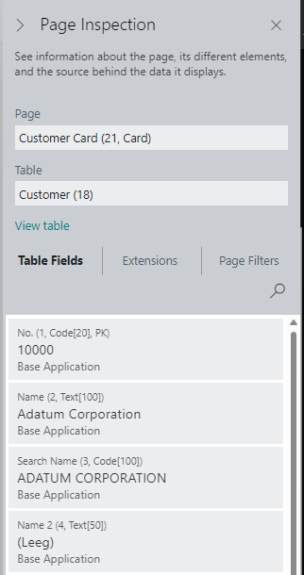
View size of text, code fields in page inspection
Business central 2022 wave 2

Slide 13
Access database row version from AL code
Business central 2022 wave 2
VS Code

Slide 14
Developers can write faster upgrade code
Business central 2022 wave 2
Only on upgrade codeunits
Uses bulk transfering insteat of row-by-row
The DataTransfer object can't be used on the following tables:
Non-SQL tables
System tables
Virtual tables
Audited tables as the destination
Obsoleted tables as the destination
https://learn.microsoft.com/en-us/dynamics365/business-central/dev-itpro/developer/devenv-data-transfer

Slide 15
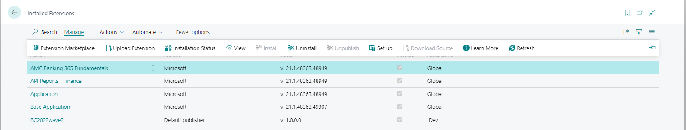
Easily access setup pages for new apps
Business central 2022 wave 2
https://learn.microsoft.com/en-us/dynamics365/business-central/dev-itpro/administration/onboarding-onboard-users-to-your-app

Slide 16
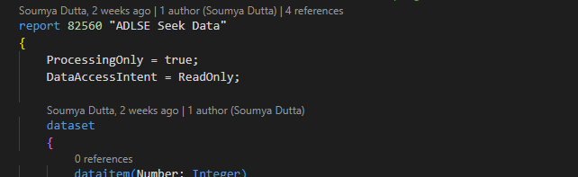
Report read-only data access
Business central 2022 wave 2
Feature management option

Slide 17
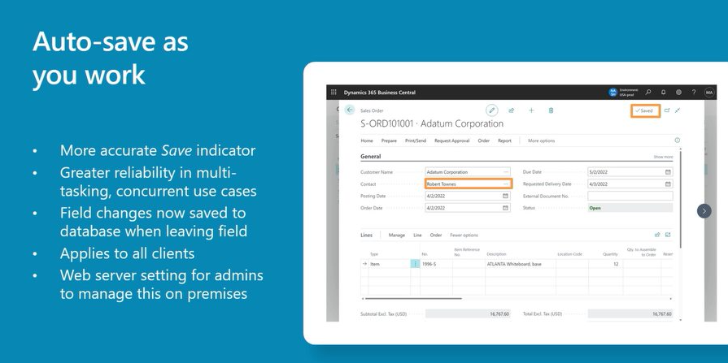
Auto-save as you work
Business central 2022 wave 2
Feature management option
Changes behaviour of the OnModify field!

Slide 18
Performance profiler
Business central 2022 wave 2
BC20

Slide 19
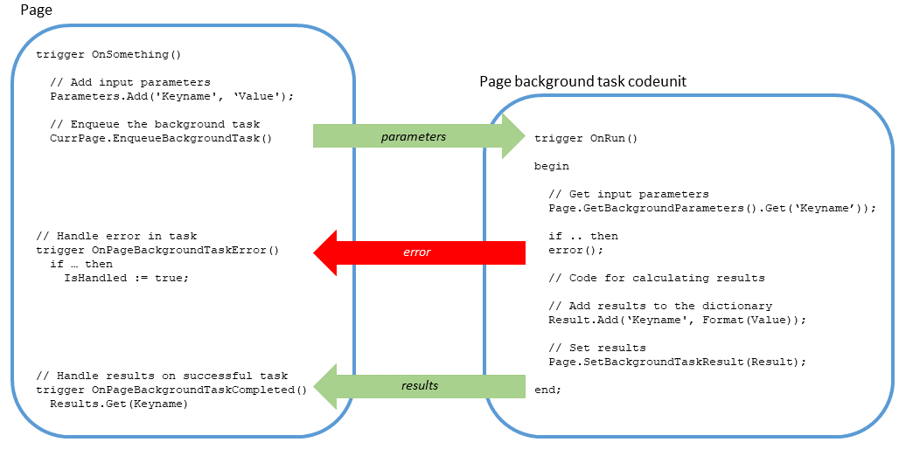
Background tasks
Business central 2022 wave 2
Page Background Tasks - Business Central | Microsoft Learn

Slide 20
Excel Layouts
Business central 2022 wave 2
Reports not anymore in RDLC
Only for documents

